Slide 1

Internals, Examples
& FUTURE
Udo Eisenbarth*, Yannik Zobus, Zsuzsanna Major, and Vincent Bagnoud
*u.eisenbarth@gsi.de

Slide 2







Software architecture I
Design considerations
Flexible usage
Direct library usage for own (rust) projects
GUI
Integrate in custom projects as web service
Contribute / integrate own (C/C++, Python, Javscript, …) code
Flexible platforms
PC (Windows, Mac, Linux)
Mobile devices (e.g.Tablet)
Web interface
https://www.thrill-project.eu/

Slide 3
Software architecture II
OPOSSUM core library
External modules
Command line interface
Rust
C/C++
Python
.NET / C#
Javascript
Julia
…
Rust
Backend Server
HTTP
GUI Frontend
https://www.thrill-project.eu/

Slide 4

Status
Currently: Focus has been on ray-tracing capabilities
Released v. 0.6: LIDT / ghost-focus analysis, released Dec. 2024
Started v. 0.7: GUI implementation for drag & drop optical-system design
Code statistics: - 45 000 lines of code, 6100 lines of comments,
- 1700 commits, 340 tickets closed,
- more than 830 unit tests (≈ 90% code coverage)

Slide 5
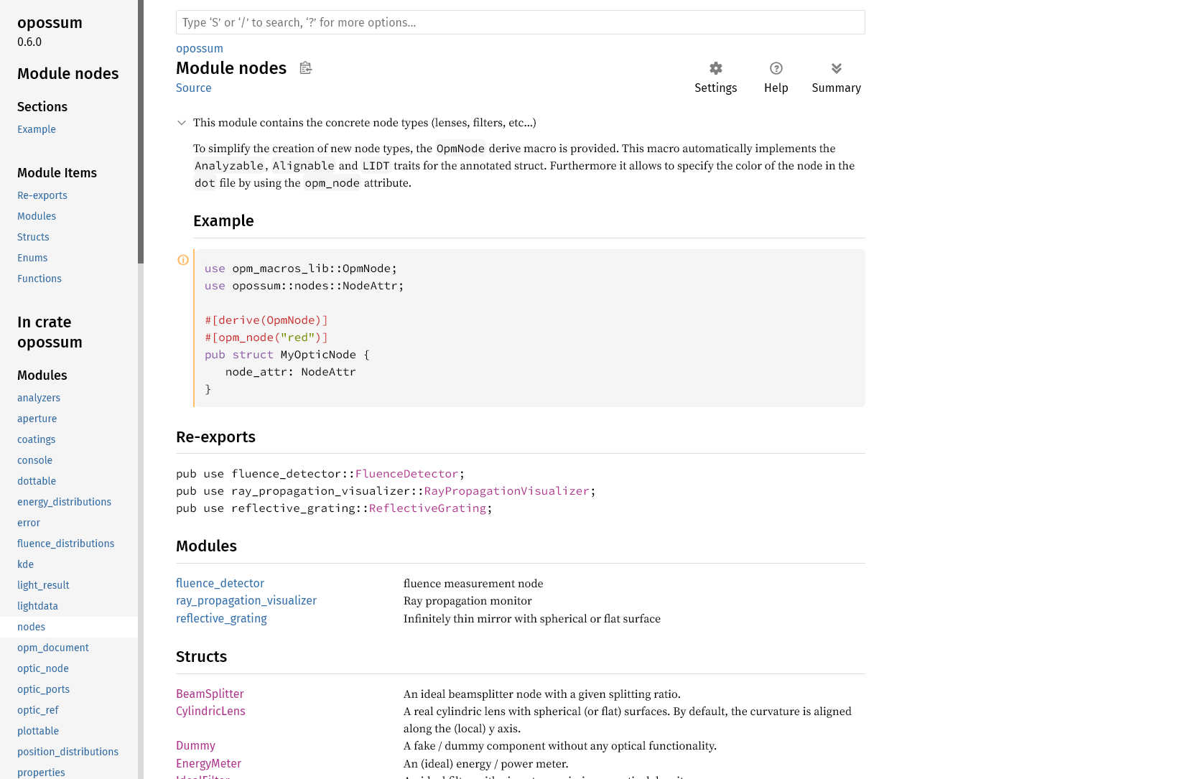
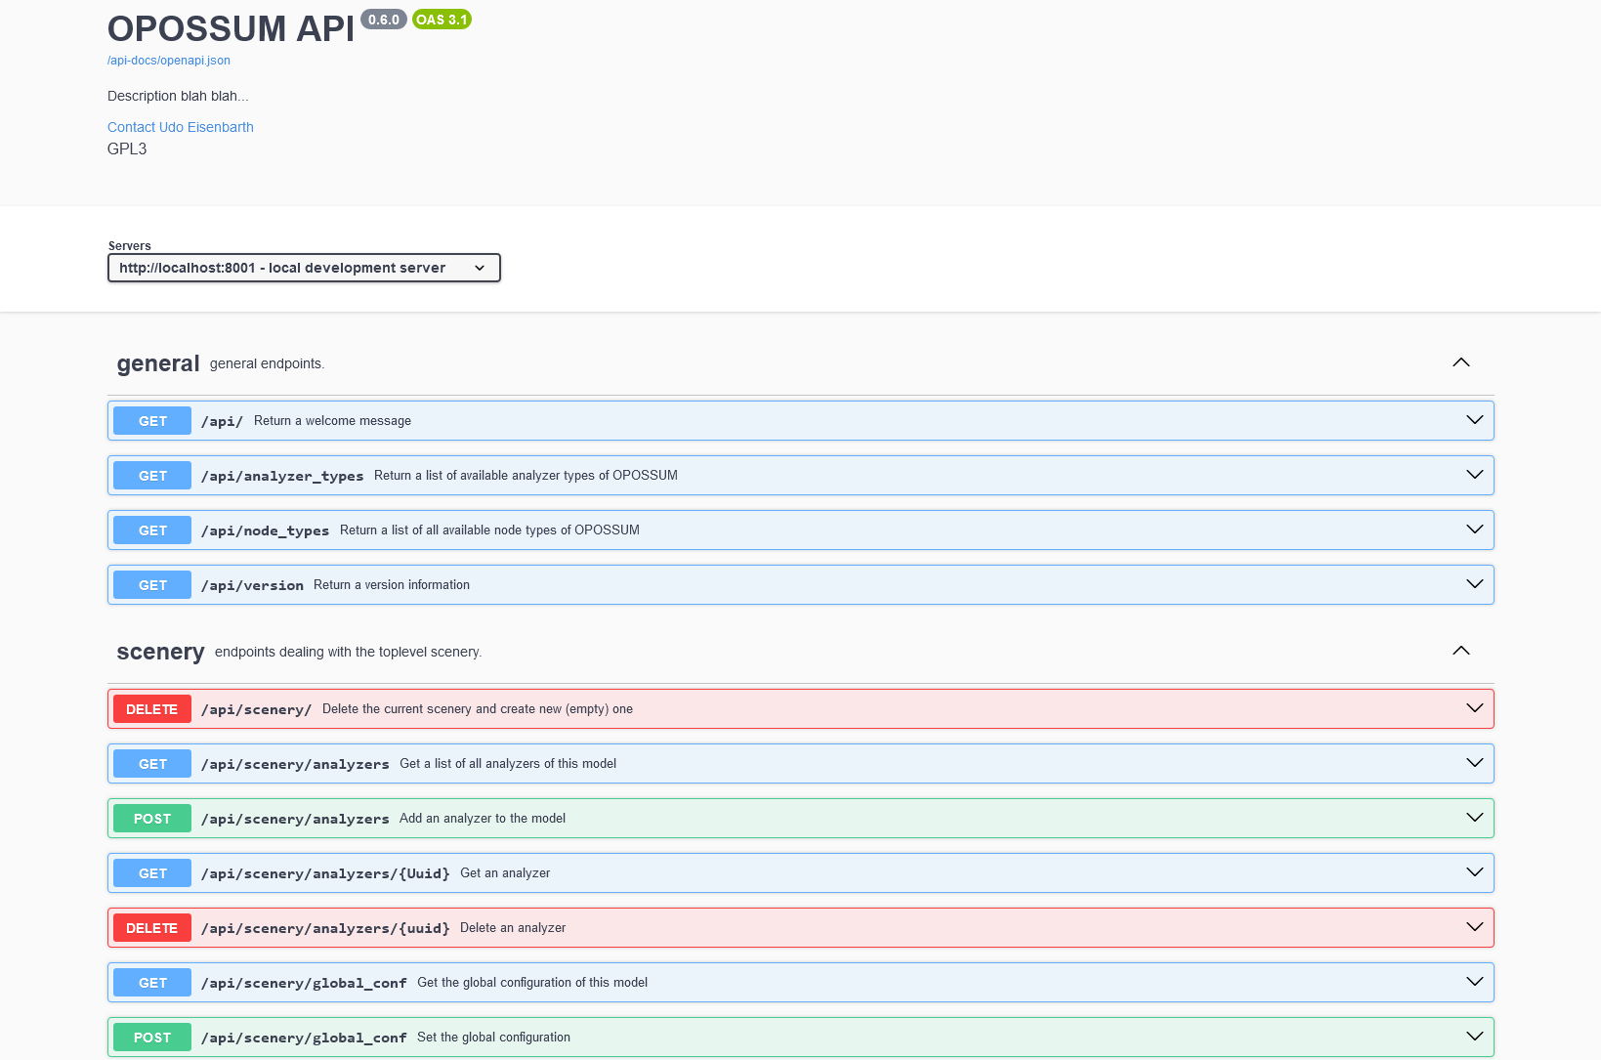
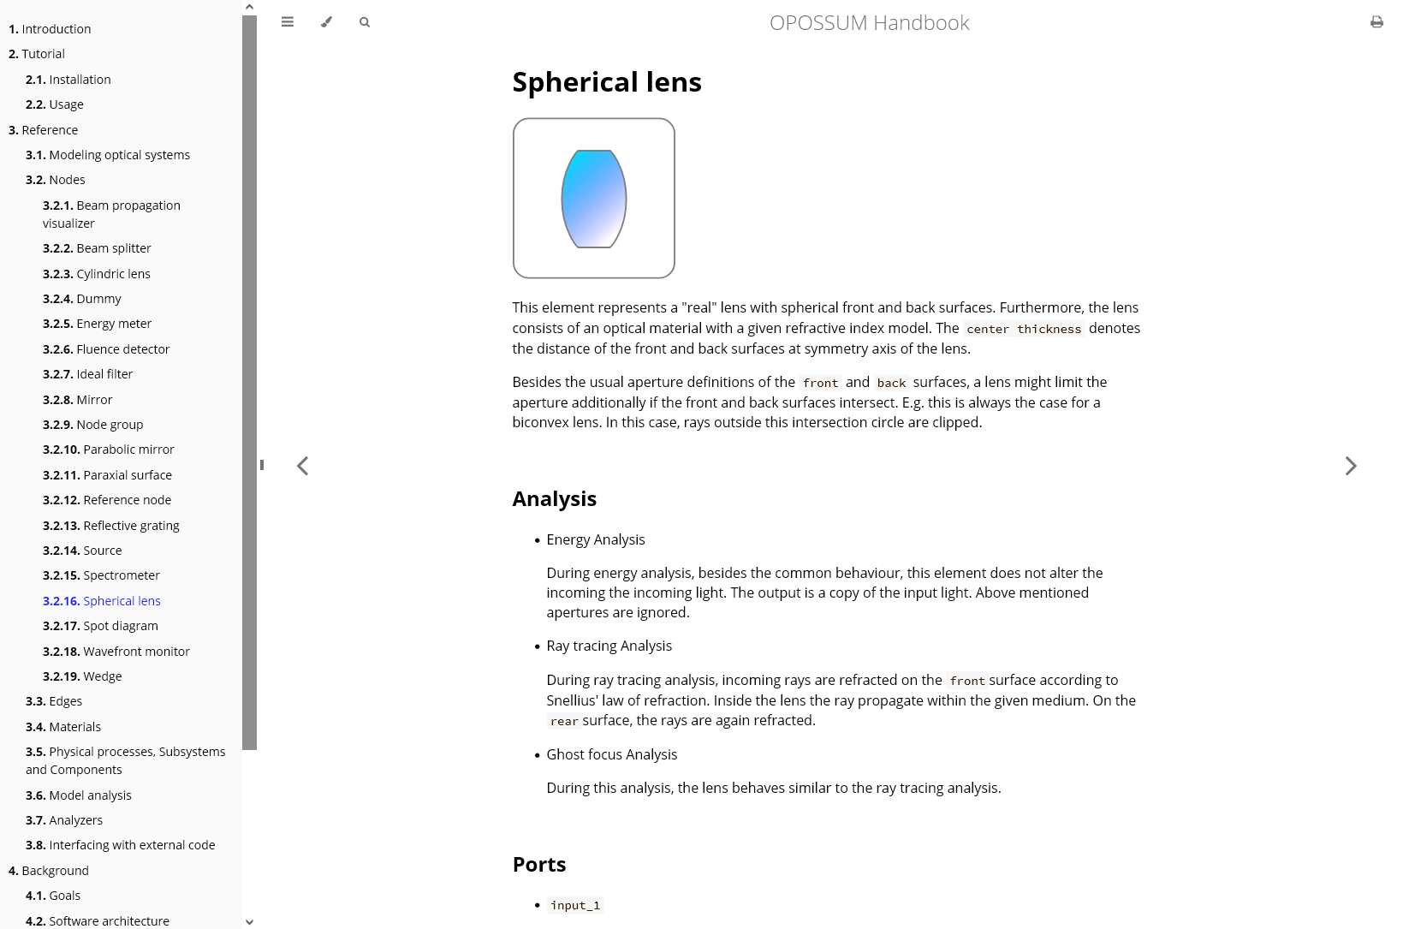
Documentation
Library documentation
RustDoc framework
Web service documentation
OpenAPI 3.0 specification
OPOSSUM Handbook
Website, PDF, ePUB, …
https://www.thrill-project.eu/

Slide 6
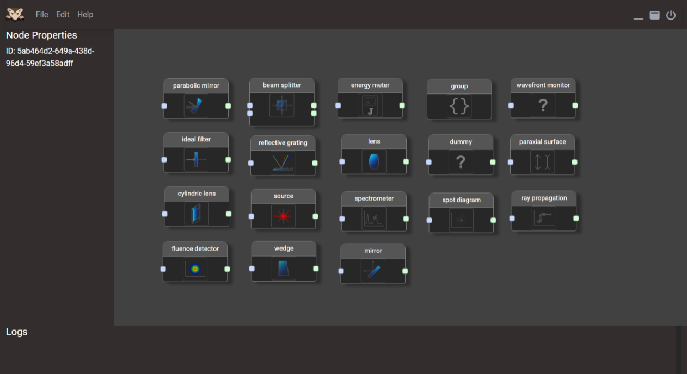
OPOSSUM GUI
Several GUI frameworks tested
Rust: eGUI, Yew, Leptos, Tauri, Ribir
Javascript: Vue, Angular, React
Dioxus Framework
Rust framework
based on HTML
platform independent
standalone (webview)
web application possible
mobile application possible
https://www.thrill-project.eu/

Slide 7
Examples

Slide 8
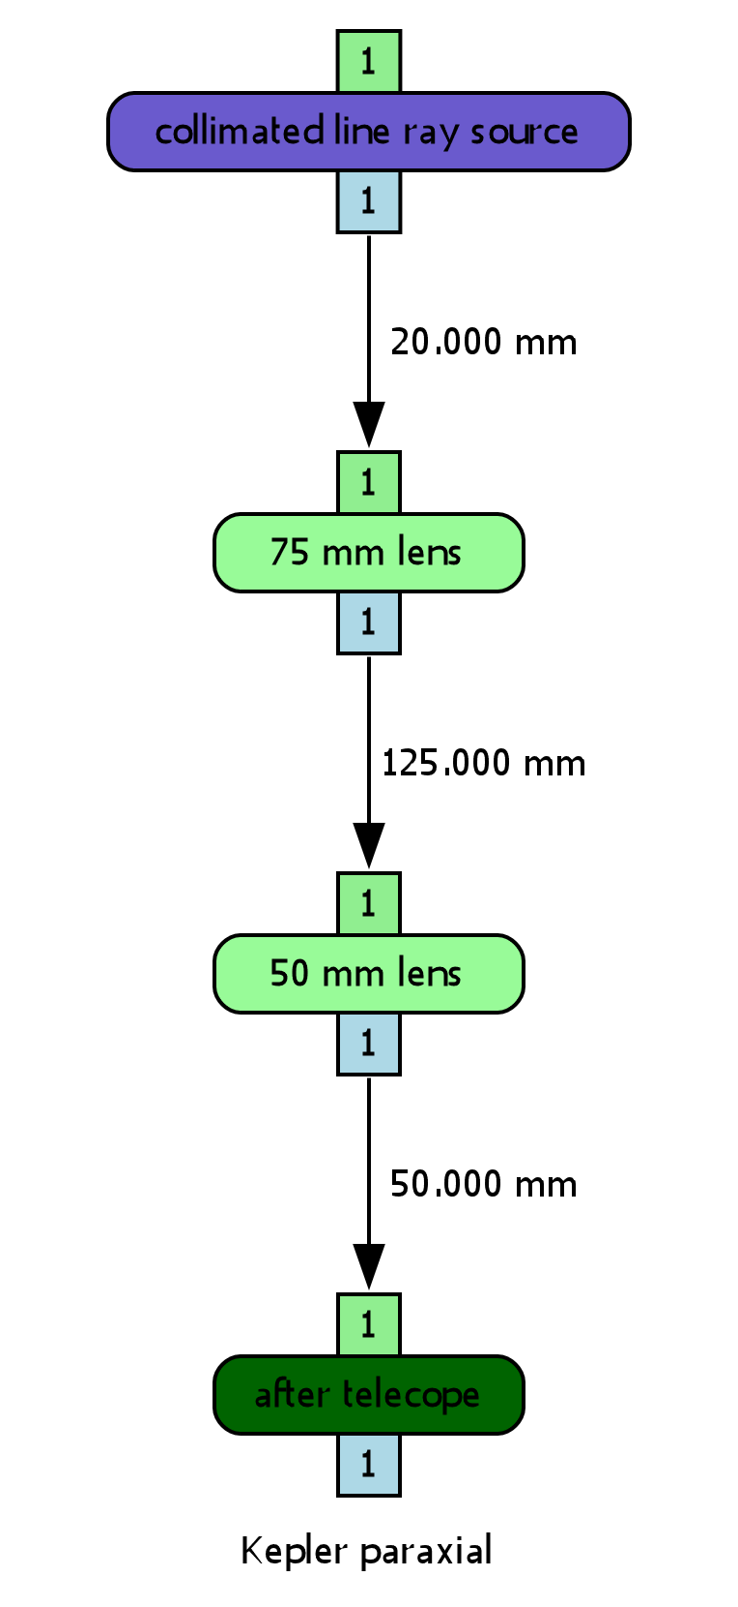
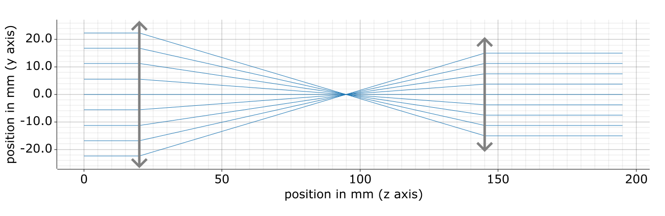
Example 1
Ideal Kepler telescope
collimated ray source (monochromatic)
paraxial surfaces (ideal lenses)
ray propagation plotter
https://www.thrill-project.eu/

Slide 9
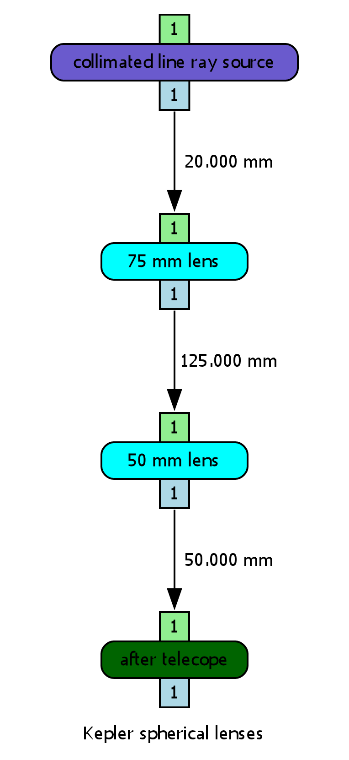
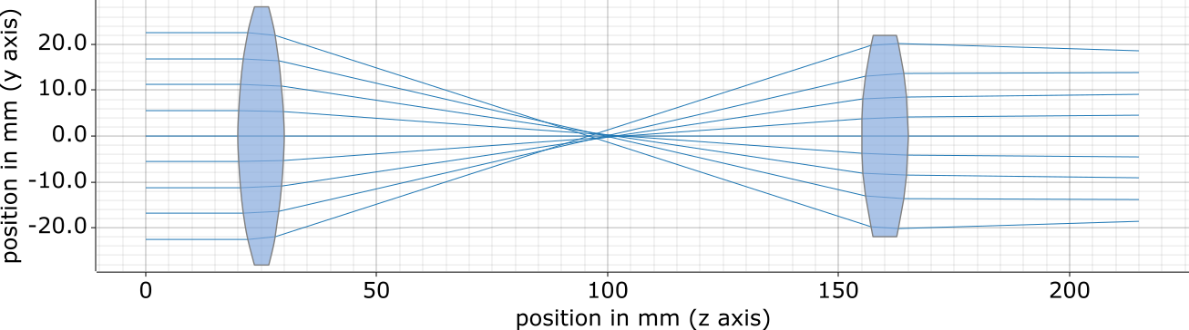
Example 2
Kepler telescope with real lenses
Same as ex. 1, but spherical lenses
material: CDGM HK51 (dense flint glass)
https://www.thrill-project.eu/

Slide 10
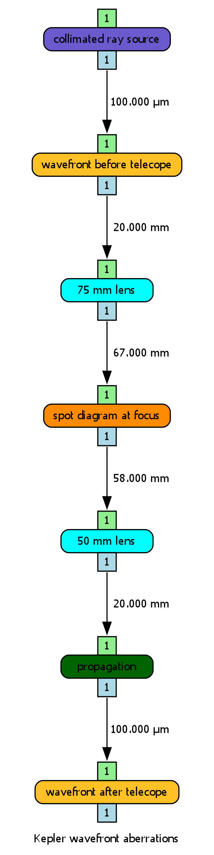
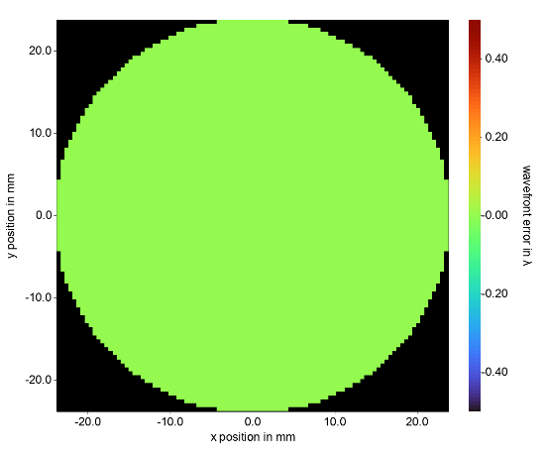
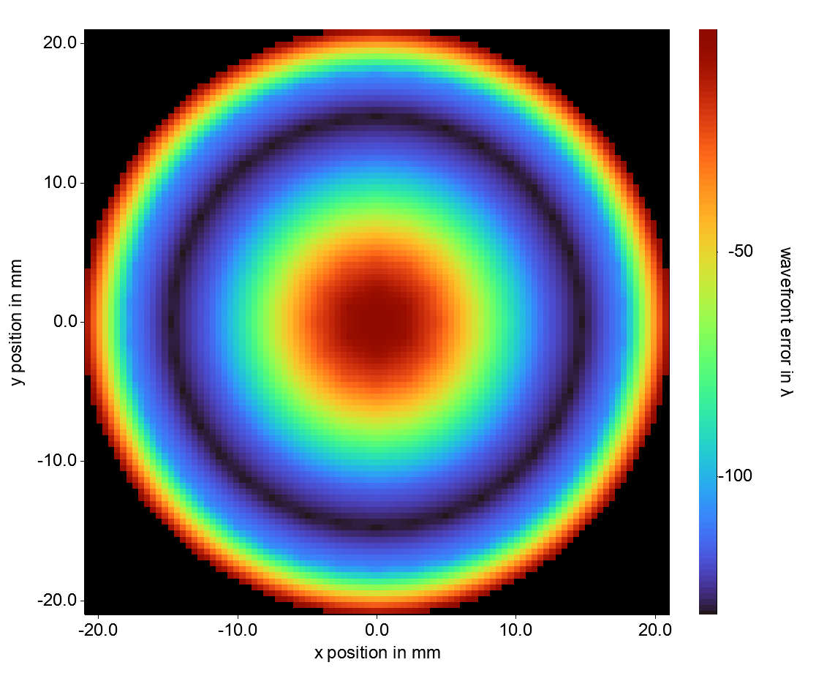
Example 3
Kepler telescope: wavefront
wavefront monitor added
input wavefront
(flat)
output wavefront
(spherical aberration)
https://www.thrill-project.eu/

Slide 11
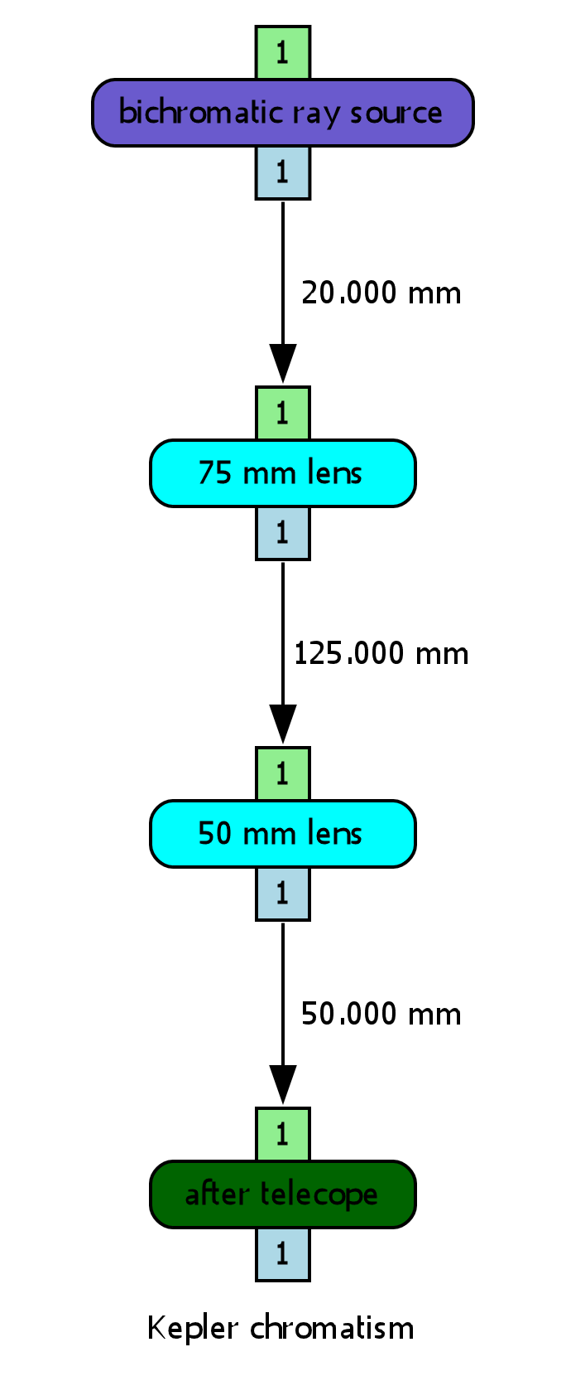
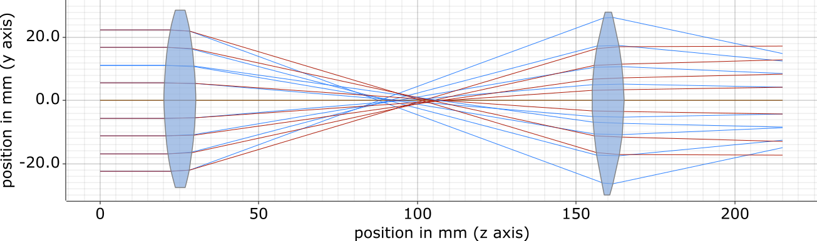
Example 4
Kepler telescope: chromatism
Same as ex. 2, but polychromatic source
350 nm & 1000 nm
https://www.thrill-project.eu/

Slide 12
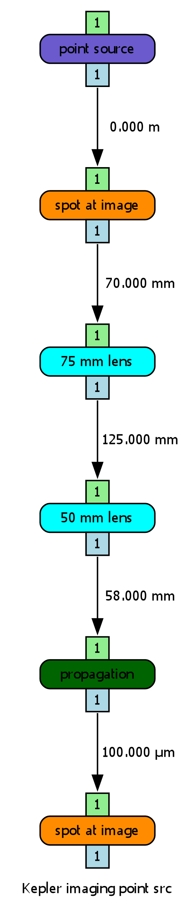
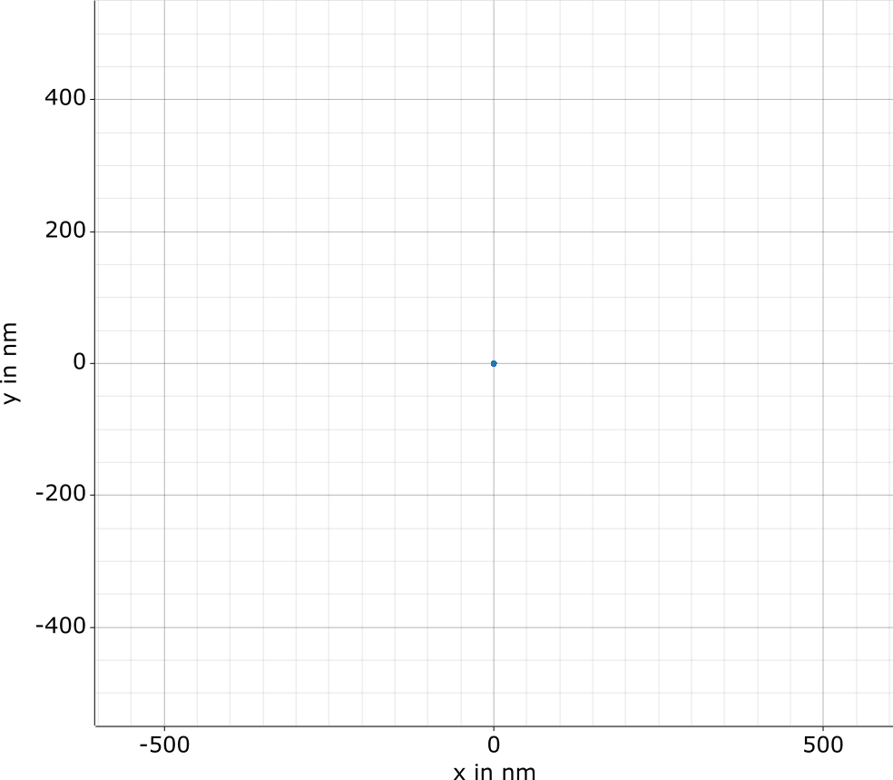
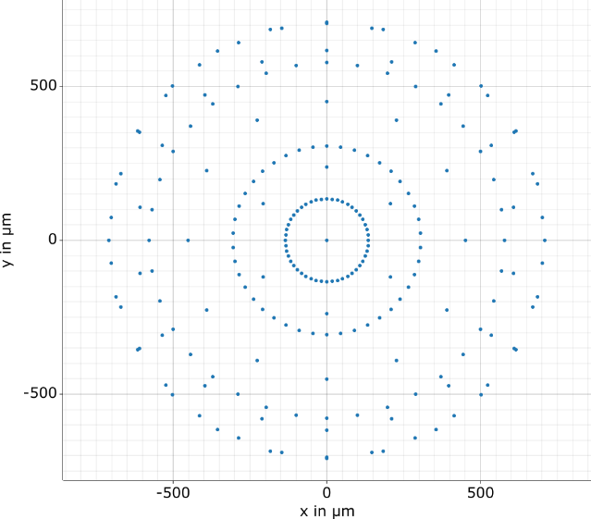
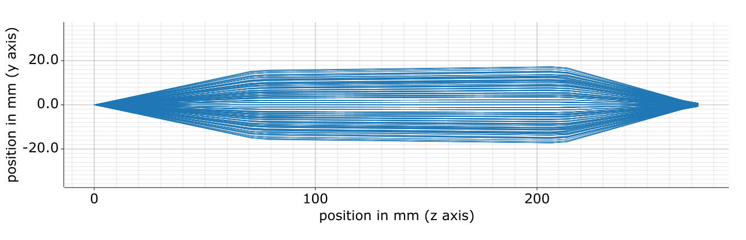
Example 5
Kepler telescope: point imaging
https://www.thrill-project.eu/

Slide 13
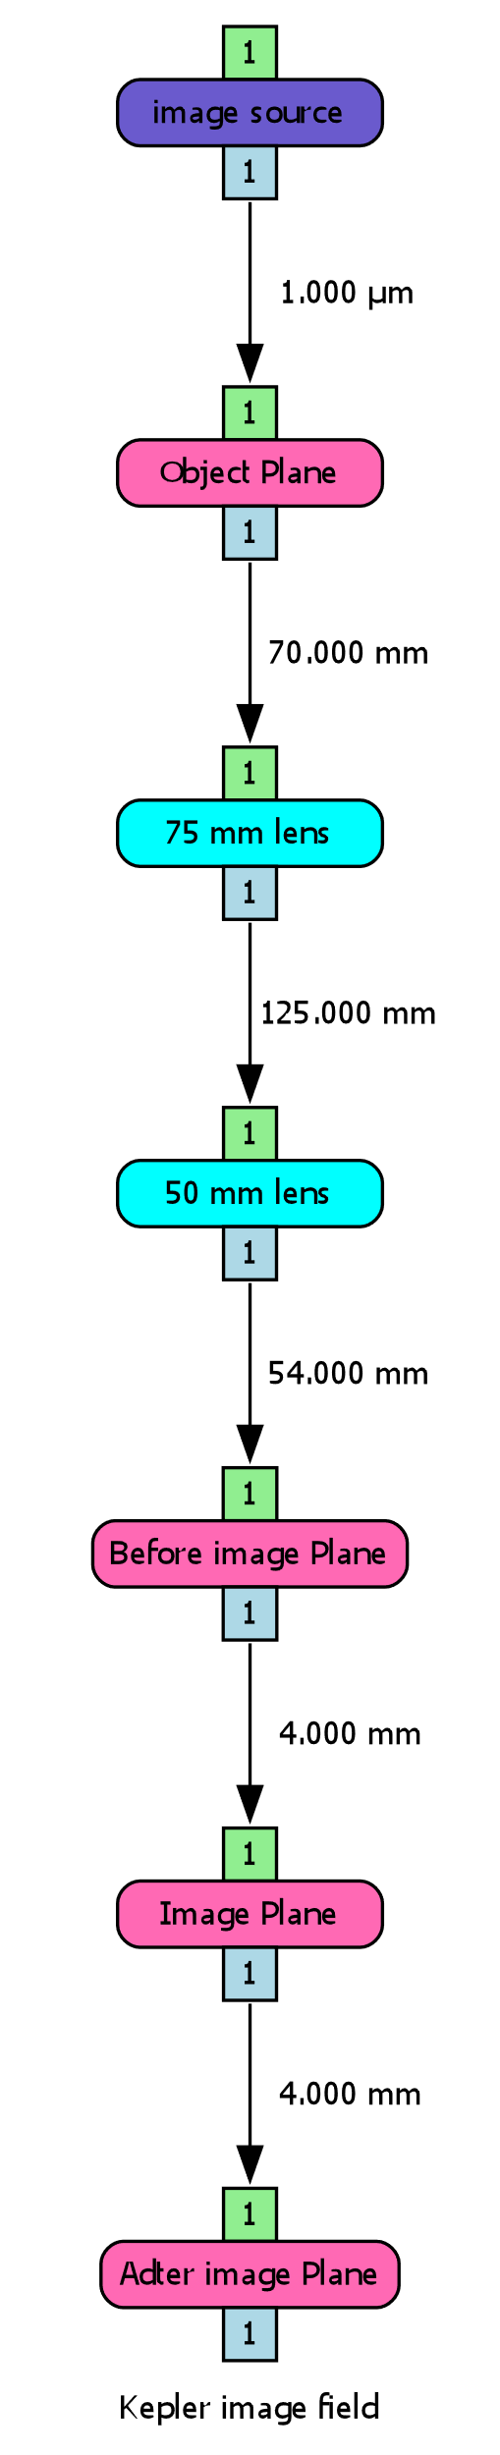
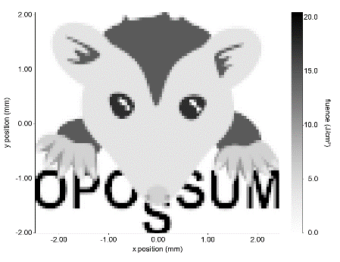
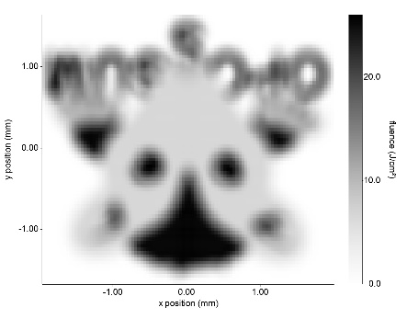
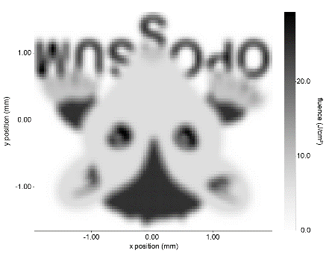
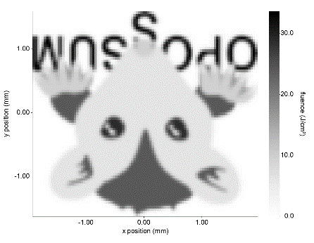
Example 6
Kepler telescope: image analysis
https://www.thrill-project.eu/

Slide 14
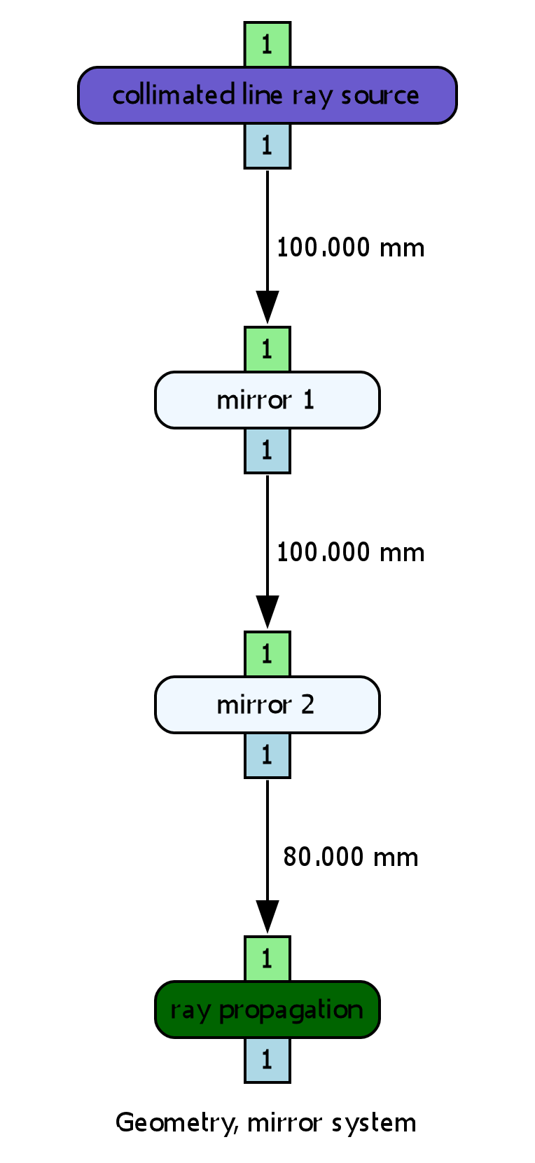
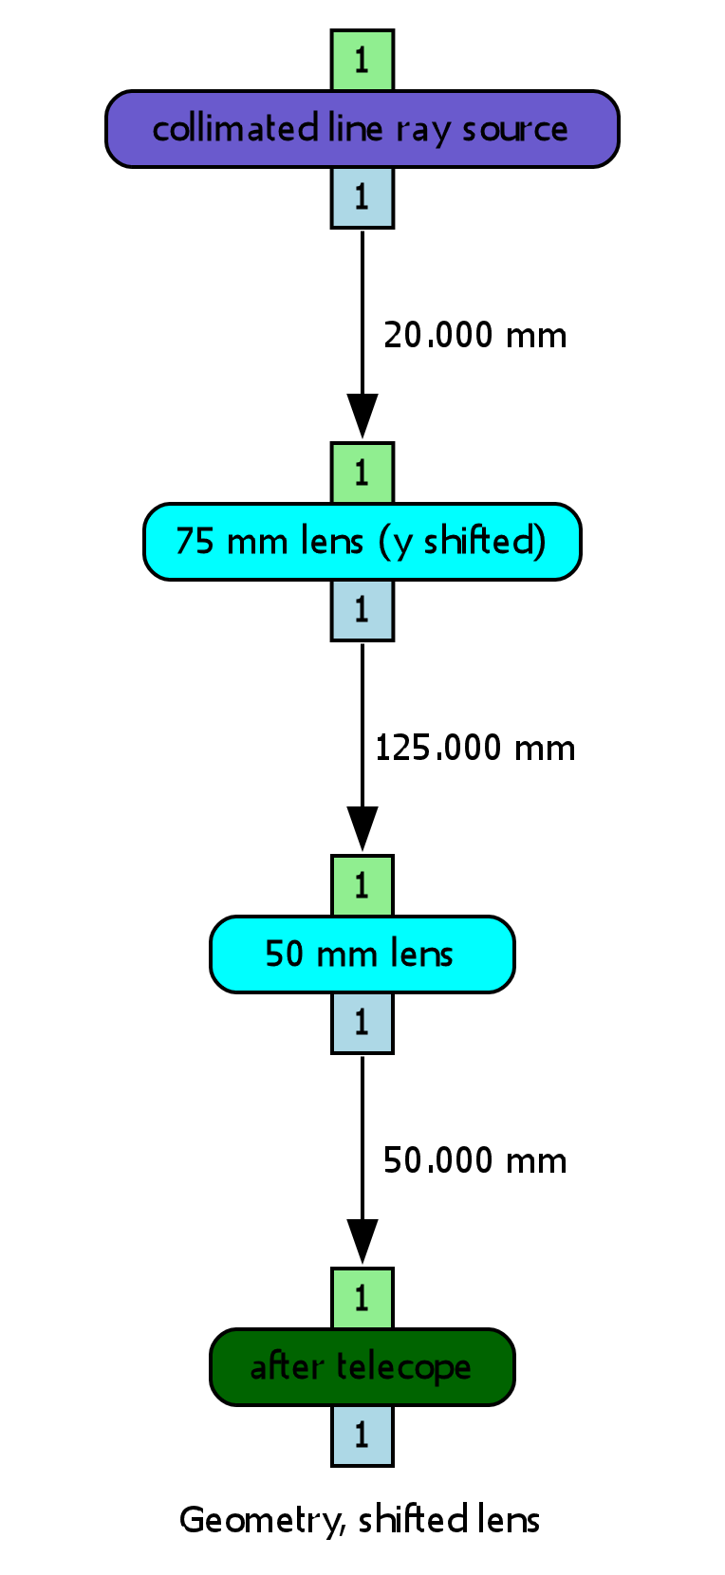
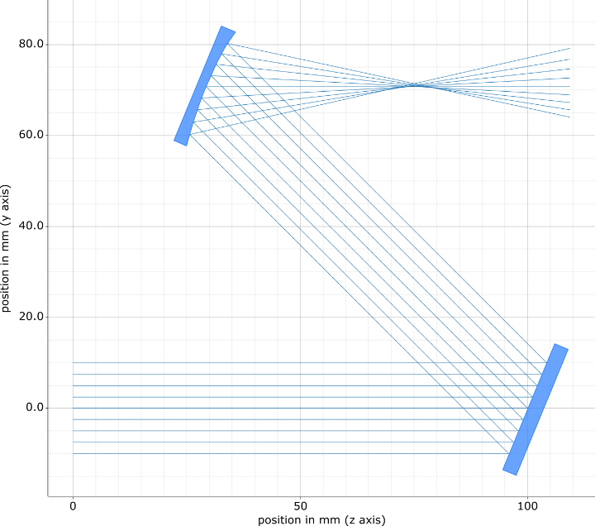
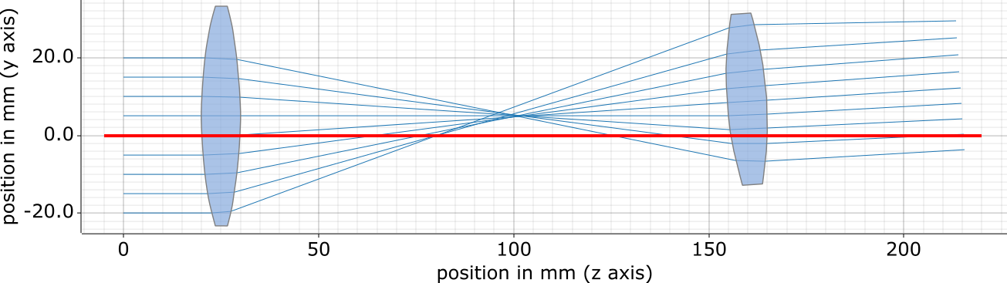
Example 7
Non-linear geometry
mirror system
shifted / tilted lens
https://www.thrill-project.eu/

Slide 15
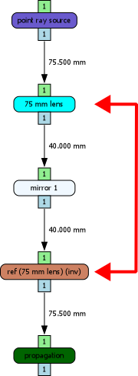
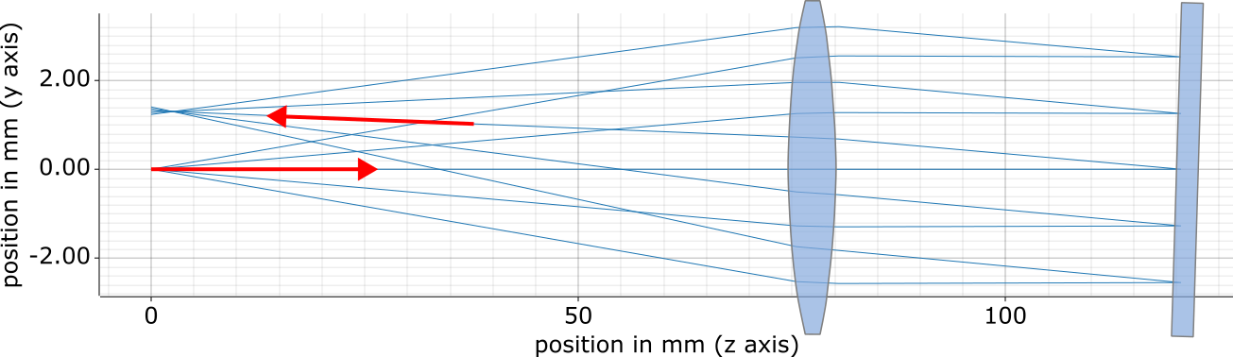
Example 8
Double-pass system: Reference node
1st pass
2nd pass
https://www.thrill-project.eu/

Slide 16
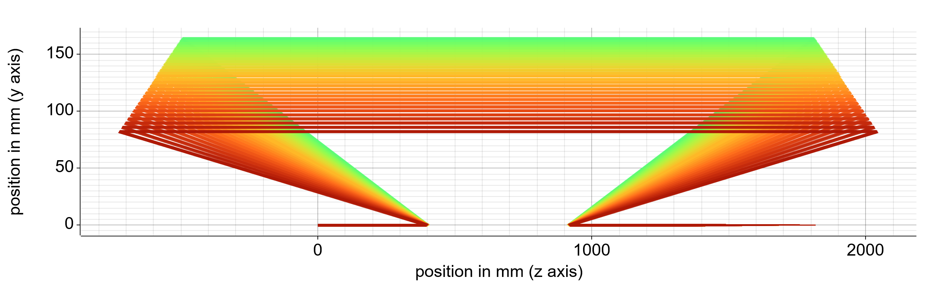
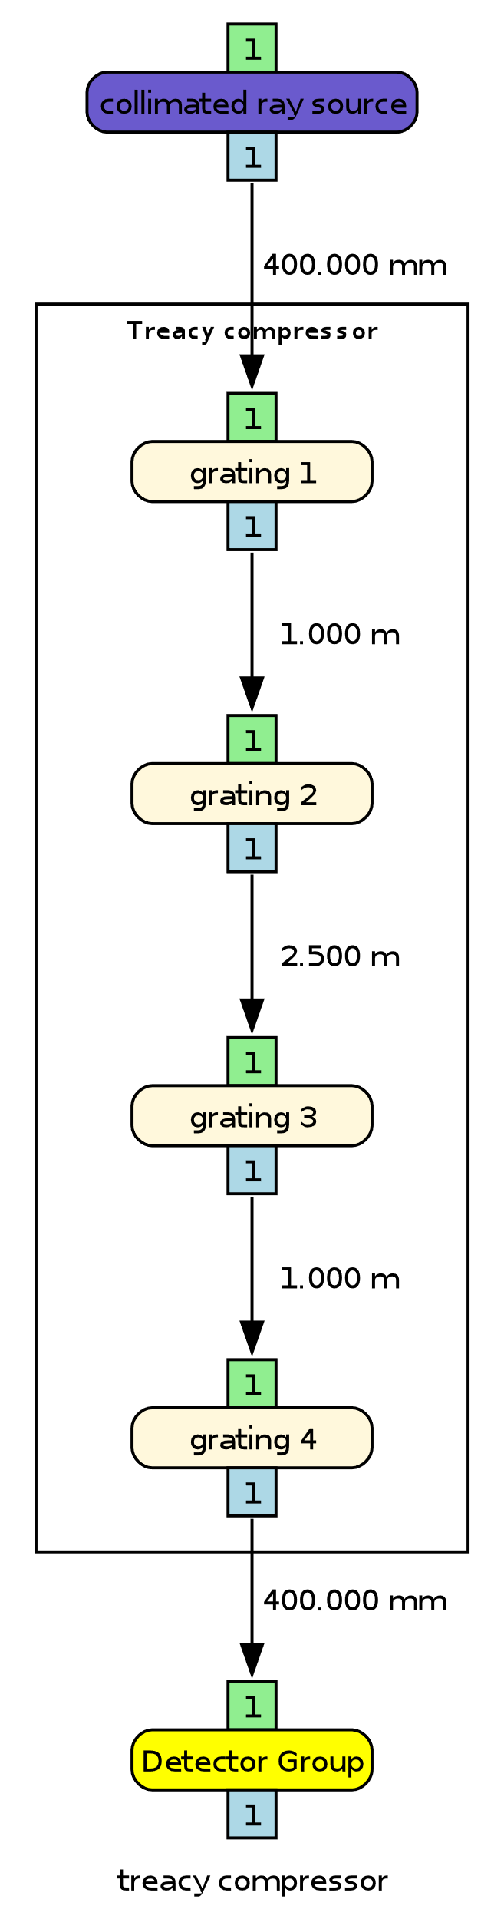
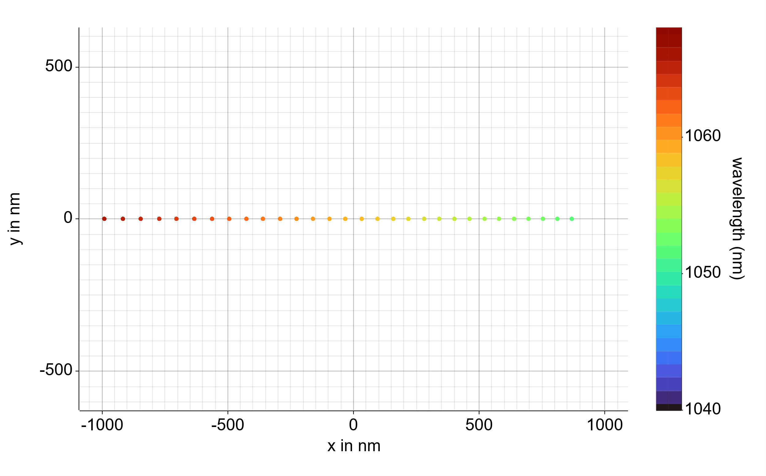
Example 9
Treacy Compressor
Tilt misalignment produces angular dispersion in FF
Grating-specific alignment mode: Alignment via deviation from Littrow angles at defined wavelength
https://www.thrill-project.eu/

Slide 17
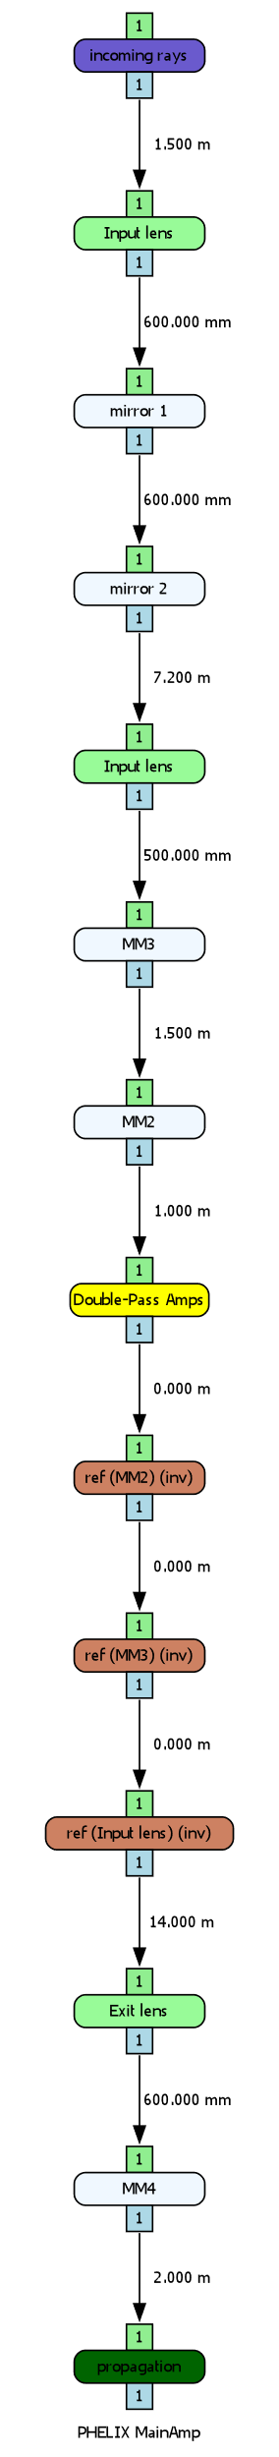
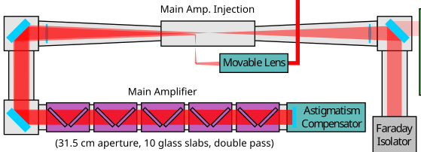
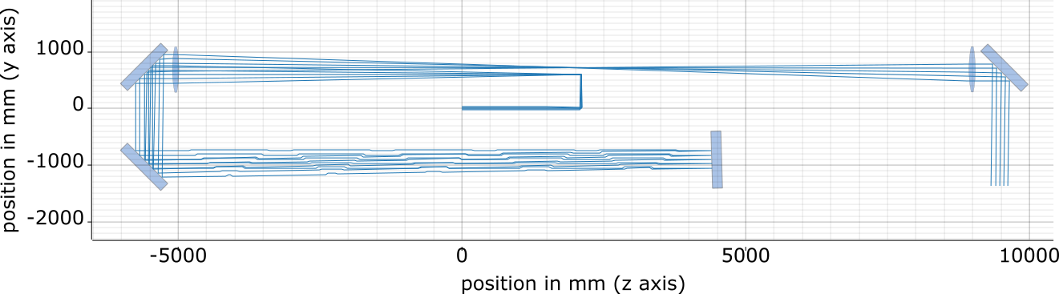
Example 10
PHELIX MainAmp
https://www.thrill-project.eu/

Slide 18
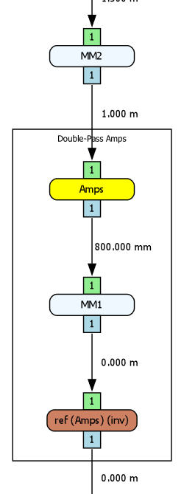
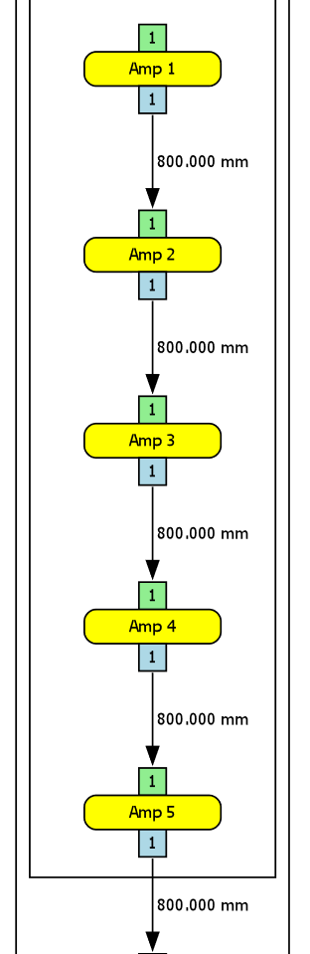
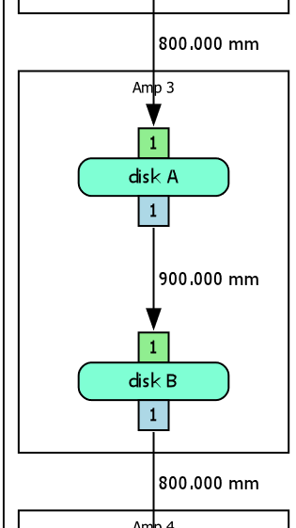
Example 10
Component Grouping
PHELIX MainAmp contains > 30 elements
https://www.thrill-project.eu/

Slide 19
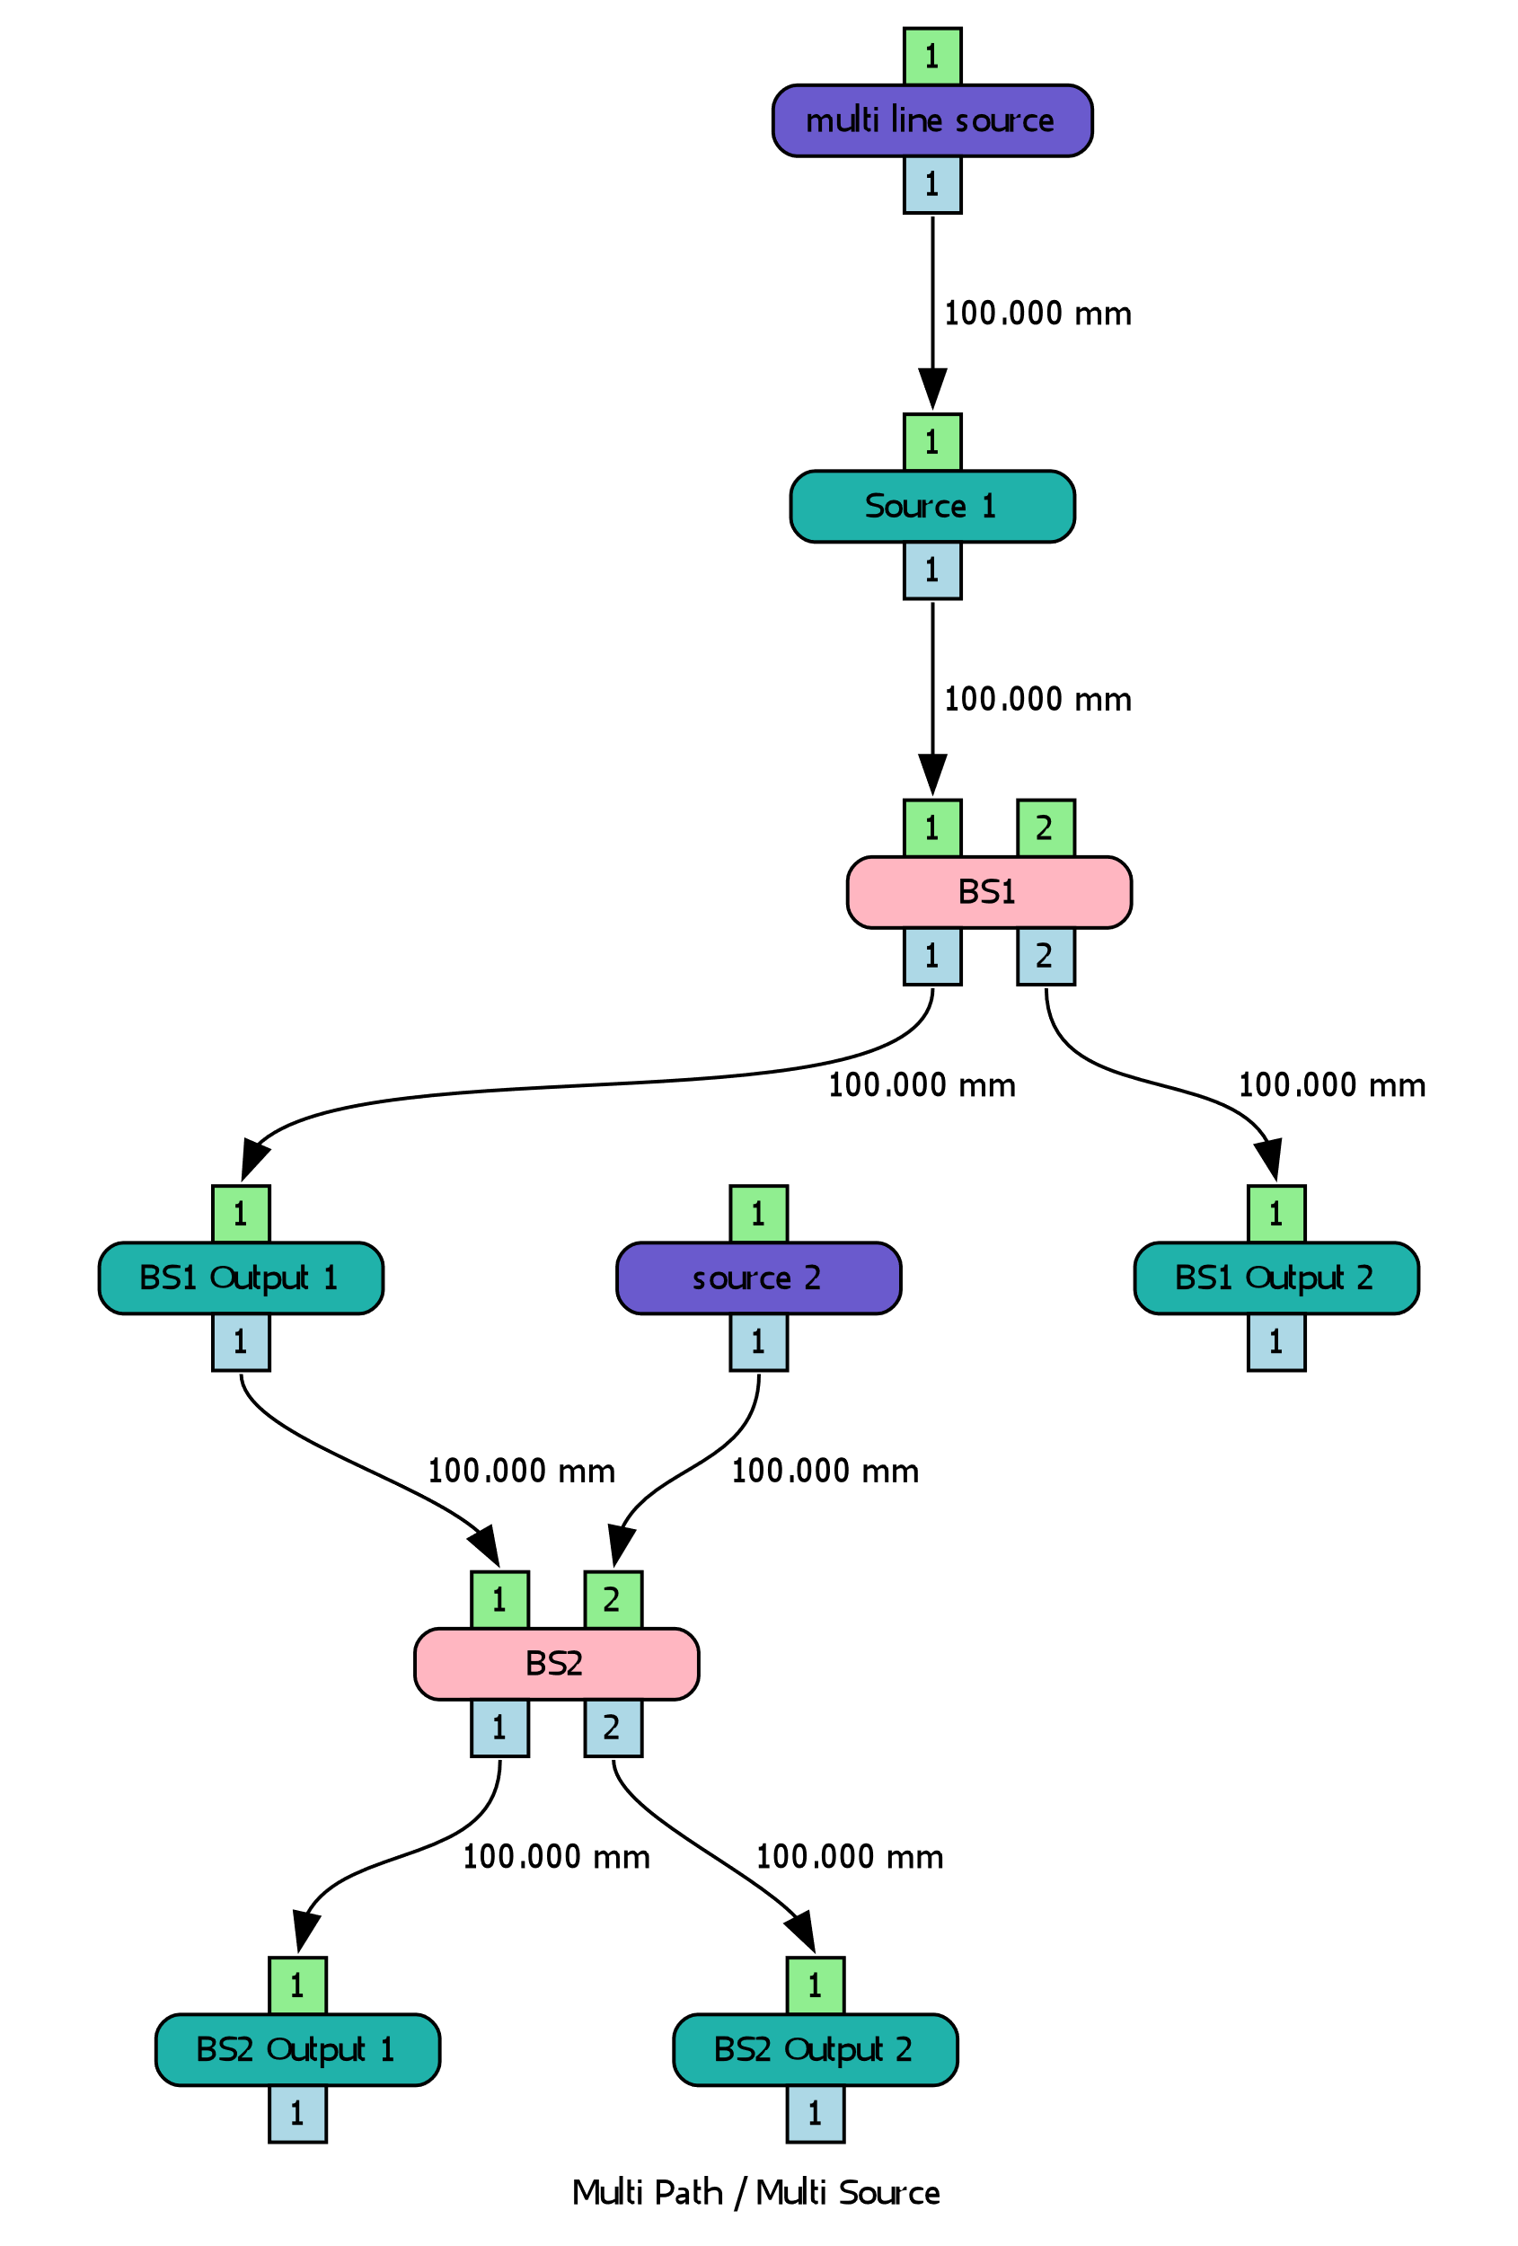
Example 11
Multi Path Systems
sources
beam splitter
beam splitter / combiner
https://www.thrill-project.eu/

Slide 20
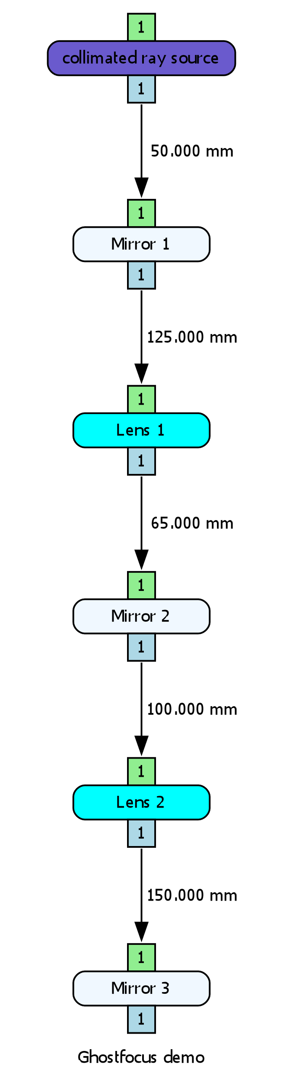
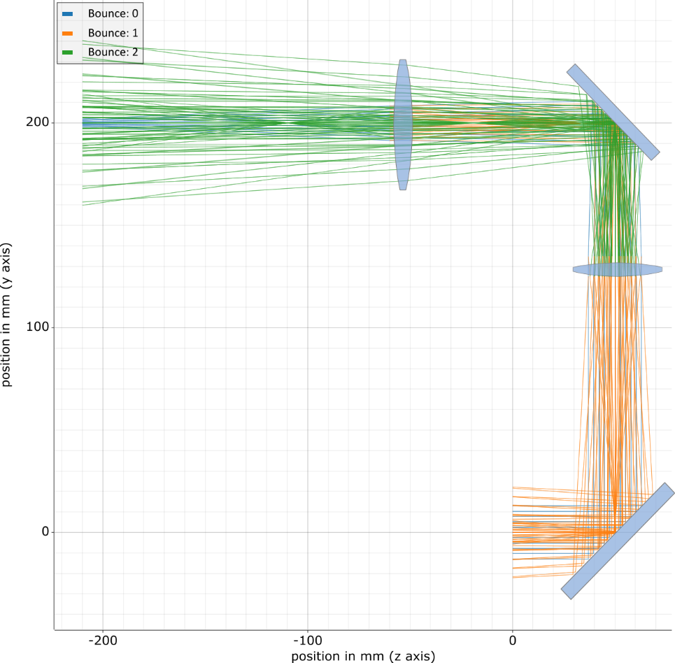
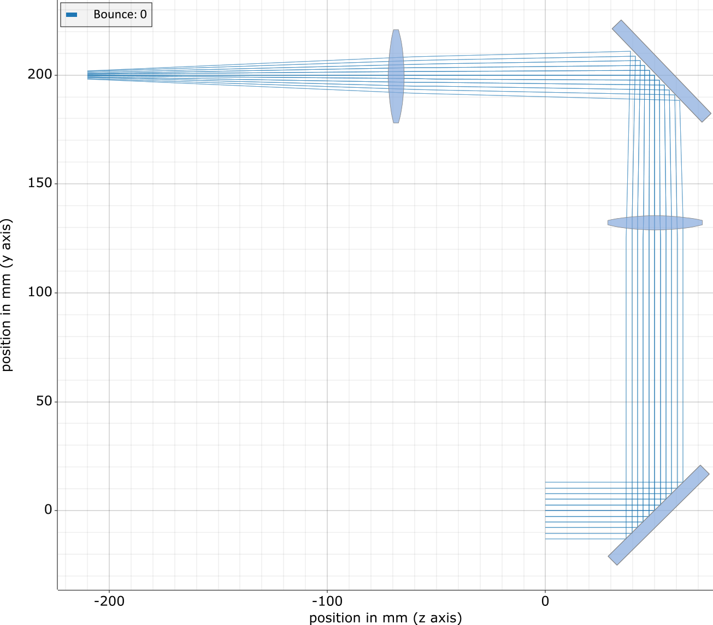
Example 12
Full system ghost focus calculation
single-pass
(no reflection)
up to 2 bounces
Source
d = 30 mm
E = 2 J
Optics
LIDT: 1 J / cm²
Lens 1: R = 0.5 %
Lens 2: R = 20 %
https://www.thrill-project.eu/

Slide 21
FUTURE &
Planned Features

Slide 22
External CODE
Add new nodes with custom code
Rust has very good interoperability features in particular for
C / C++
Python
Java
.NET (C#)
…
Custom code
fn get_properties(props) {
…
}
fn define_ports() {
…
}
fn analyze(inputs) -> outputs {
…
}
Custom node
Properties
Analysis
First test candidates could be
Second Harmonic Generation (GSI, Python)
HASEonGPU (HZDR, C/C++)
https://www.thrill-project.eu/

Slide 23
Further planned features
Planned milestones
Started v. 0.7: GUI implementation for drag & drop optical-system design
Start version 0.8: Amplification + polarization handling
Future implementations
Additional nodes: polarizers, three-wave-mixing, etc.
Optical setup optimizers
Cyclic graphs (resonators)
New analyzer modes:
Gaussian mode propagation
Fourier optics
https://www.thrill-project.eu/

Slide 24

Thanks for your attention
Now it‘s your turn !!!

